Slide 1
Security Documentation: Procedures
Policies
Standards
Procedures
Guidelines
https://frsecure.com/blog/differentiating-between-policies-standards-procedures-and-guidelines/

Slide 2
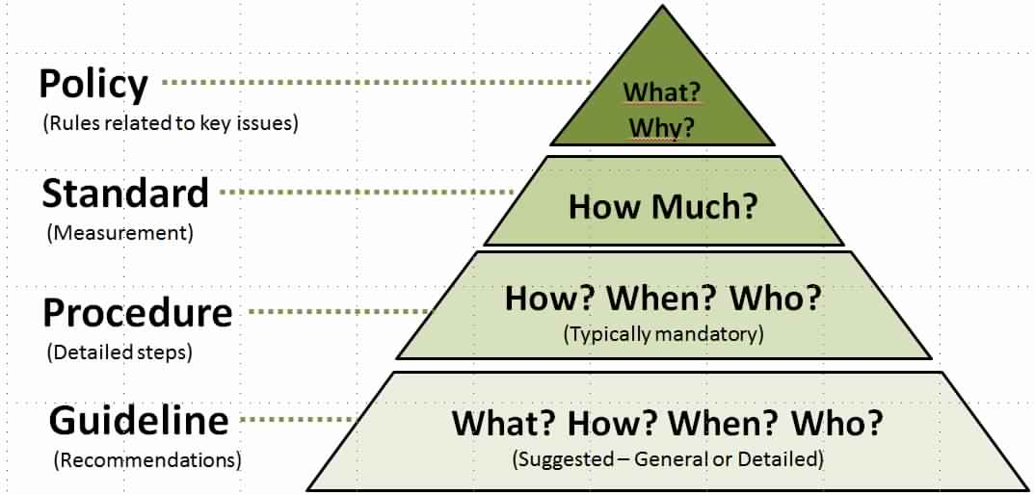
Security Documentation: Procedures
https://frsecure.com/blog/differentiating-between-policies-standards-procedures-and-guidelines/

Slide 3
Security Documentation: Procedures
Procedures
Procedures are detailed step by step instructions to achieve a given goal or mandate. They are typically intended for internal departments and should adhere to strict change control processes.

Slide 4
Security Documentation: Procedures
Procedures
Procedures can be developed as you go. If this is the route your organization chooses to take it’s necessary to have comprehensive and consistent documentation of the procedures that you are developing.

Slide 5
Security Documentation: Procedures
Procedures
Often act as the “cookbook” for staff to consult to accomplish a repeatable process.

Slide 6
Security Documentation: Procedures
Procedures
2. Detailed enough and yet not too difficult that only a small group (or a single person) will understand.

Slide 7
Security Documentation: Procedures
Procedures
3. Installing operating systems, performing a system backup, granting access rights to a system and
setting up new user accounts are all example of procedures.

Slide 8
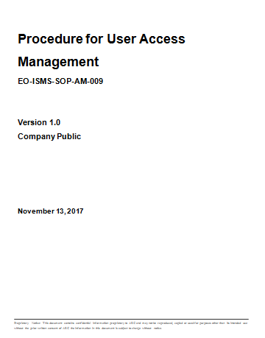
Security Documentation: Procedures
TITLE
DOC #
VERSION
CLASSIFICATION
DATE

Slide 9
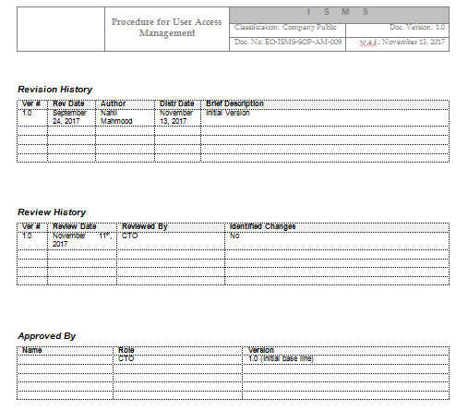
Security Documentation: Procedures
HEADER
REVISION HISTORY
REVIEW HISTORY
APPROVED BY

Slide 10
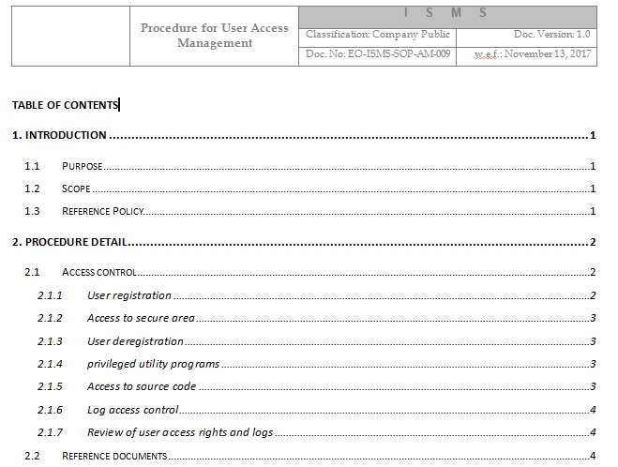
Security Documentation: Procedures
HEADER
TOC

Slide 11
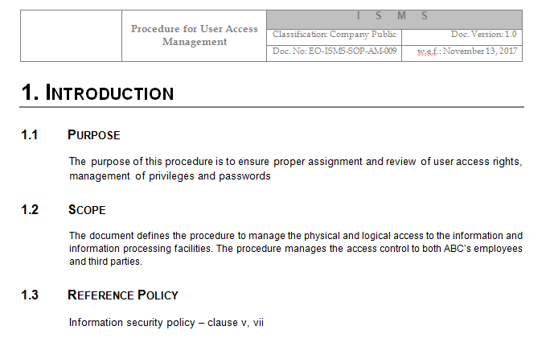
Security Documentation: Procedures
HEADER
PURPOSE
SCOPE
REF POLICY

Slide 12
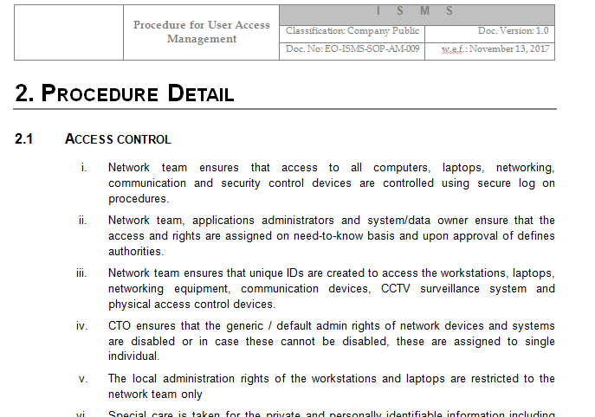
Security Documentation: Procedures
HEADER
PROCEDURE
DETAIL
…ACCESS
CONTROL

Slide 13
Security Documentation: Procedures
Policies
Standards
Procedures
Guidelines
https://frsecure.com/blog/differentiating-between-policies-standards-procedures-and-guidelines/
END

